Slide 1
Summary
Glovebox Experiments
Averaging
Deviations from literature
Calorimeter T Uncertainty
Decide wt% determination process
Anomalous Data

Slide 2
Glovebox Experiments
Goal – Explain drip from pipette
Challenges:
Recorded T varies wildly when N₂ gas is being pumped into box
Solution had to be drawn into pipette very slowly to prevent spurting
Key observation:
No apparent volumetric loss at <0 C
Conclusion:
Volumetric loss via drips accounts for most of density difference from theoretical
Drips due to vapor pressure (at 20C, it’s ~3.1 times greater than at -10C)
~0.05 g difference from theoretical (0.91)
T_box | T_Bottle | T_Cell | Mass | Vol Loss?
-10 | -8.1 | -10 | 0.8626 | 0 drips
-10 | -3 | -4.1 | 0.8718
-10 | -4.3 | -6.4 | 0.8455
0 | -6.8 | -5.2 | 0.8492
0 | -2 | 6 | 0.8216
0 | -5.4 | -1.8 | 0.8628
10 | 4.5 | 11 | 0.8304 | ~1 drip
10 | 4.7 | 12.3 | 0.8326
10 | 7 | 13.6 | 0.8442 | 1 drip
20 | 18 | 13.4 | 0.7446 | ~3 drips
20 | 19.5 | 14.8 | 0.7666
20 | 20.1 | 16 | 0.7563 | 3 drips

Slide 3
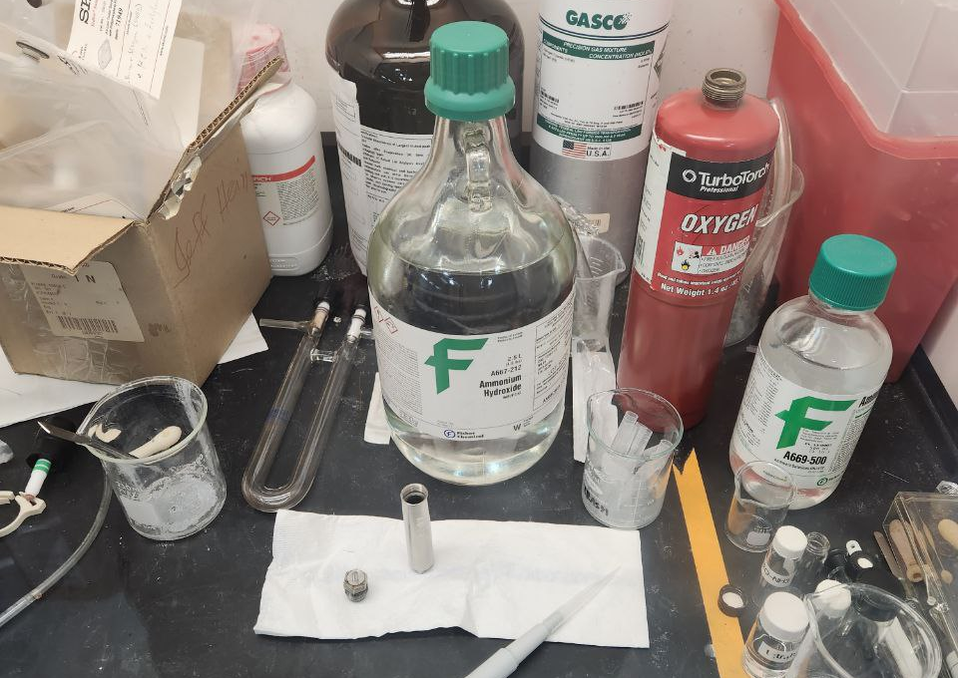
Glovebox Experiments
Supply Bottle:
We have been using A667-212 → NF/FCC Grade
Reported by Munoz-Iglesias 2018 is ACS Certified Plus Grade (A669-500)

Slide 4
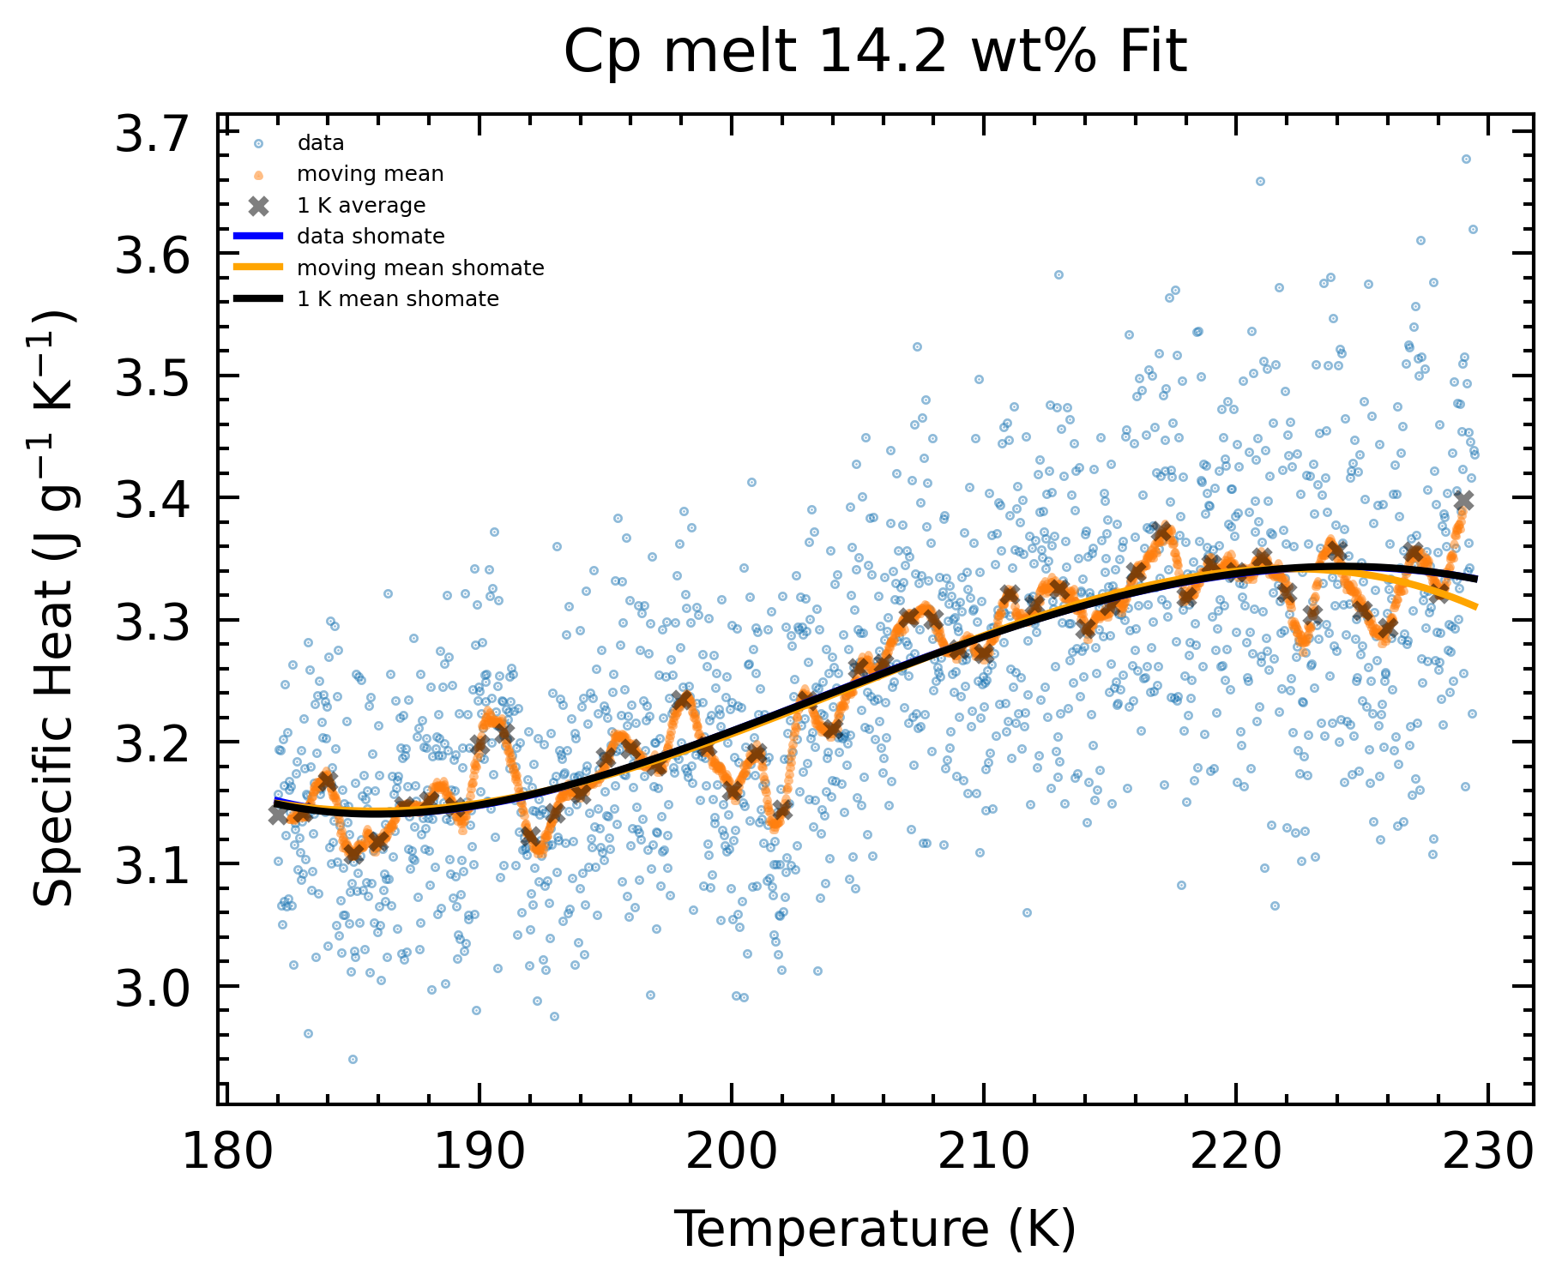
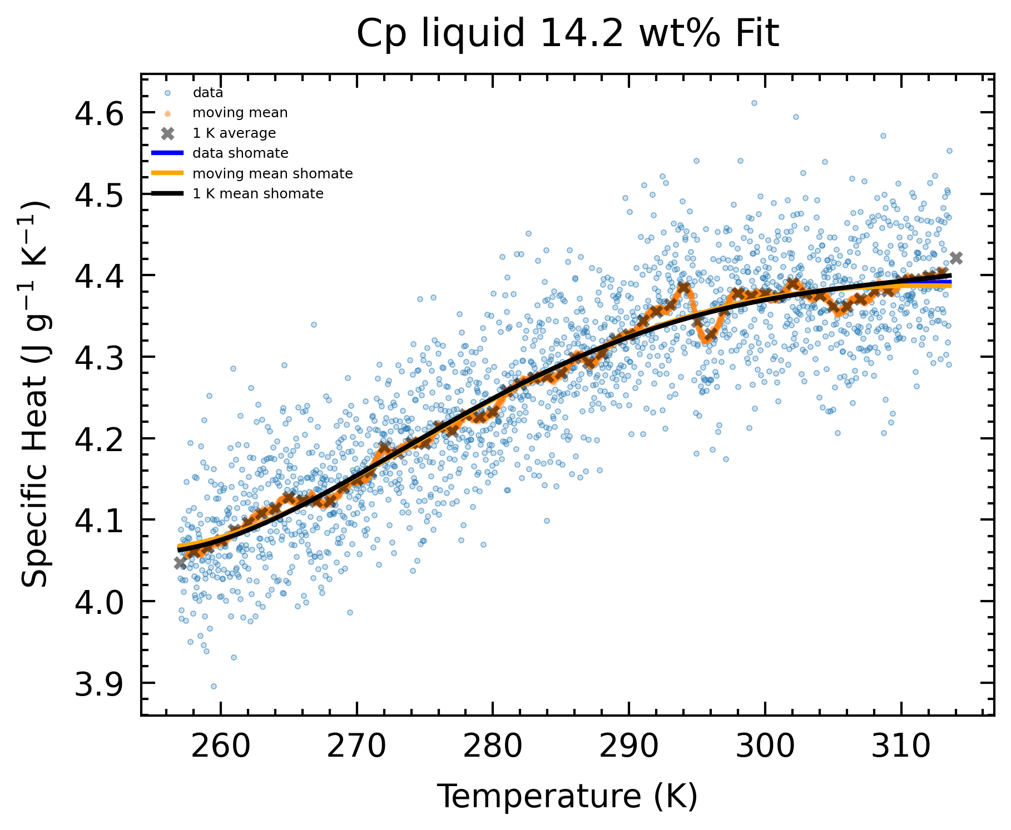
Average smoothing (moving mean, 1 K mean)
Reasons for variability:
Melt: propagated variability in calculations: d_T, d_crystalFraction

Slide 5
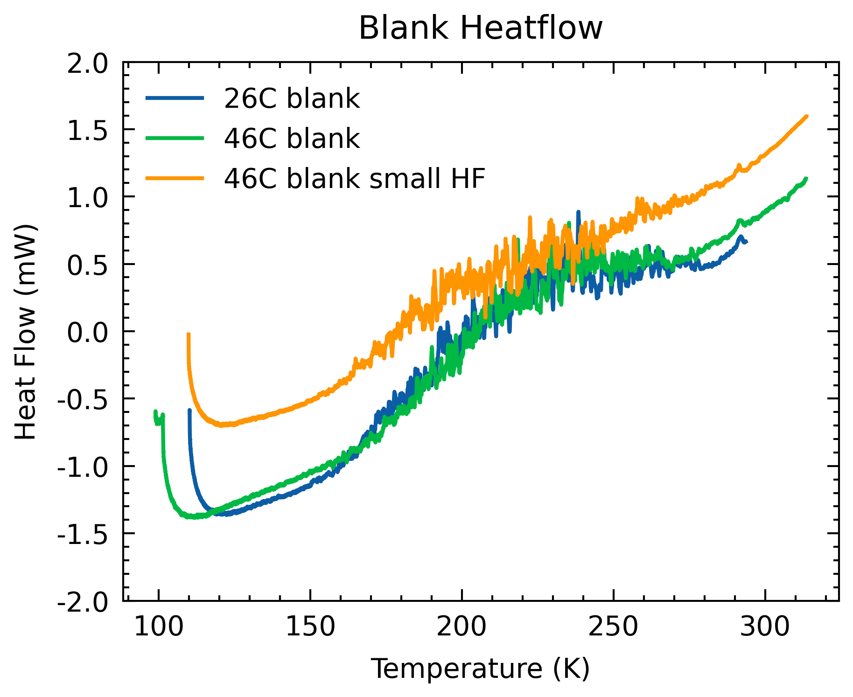
Average smoothing
Reasons for variability:
Melt: propagated variability in calculations: d_T, d_crystalFraction
Both: variability in blank – blank subtraction not perfect, noise variable for different runs (can I use deviations between blank HF as calorimeter noise?)

Slide 6
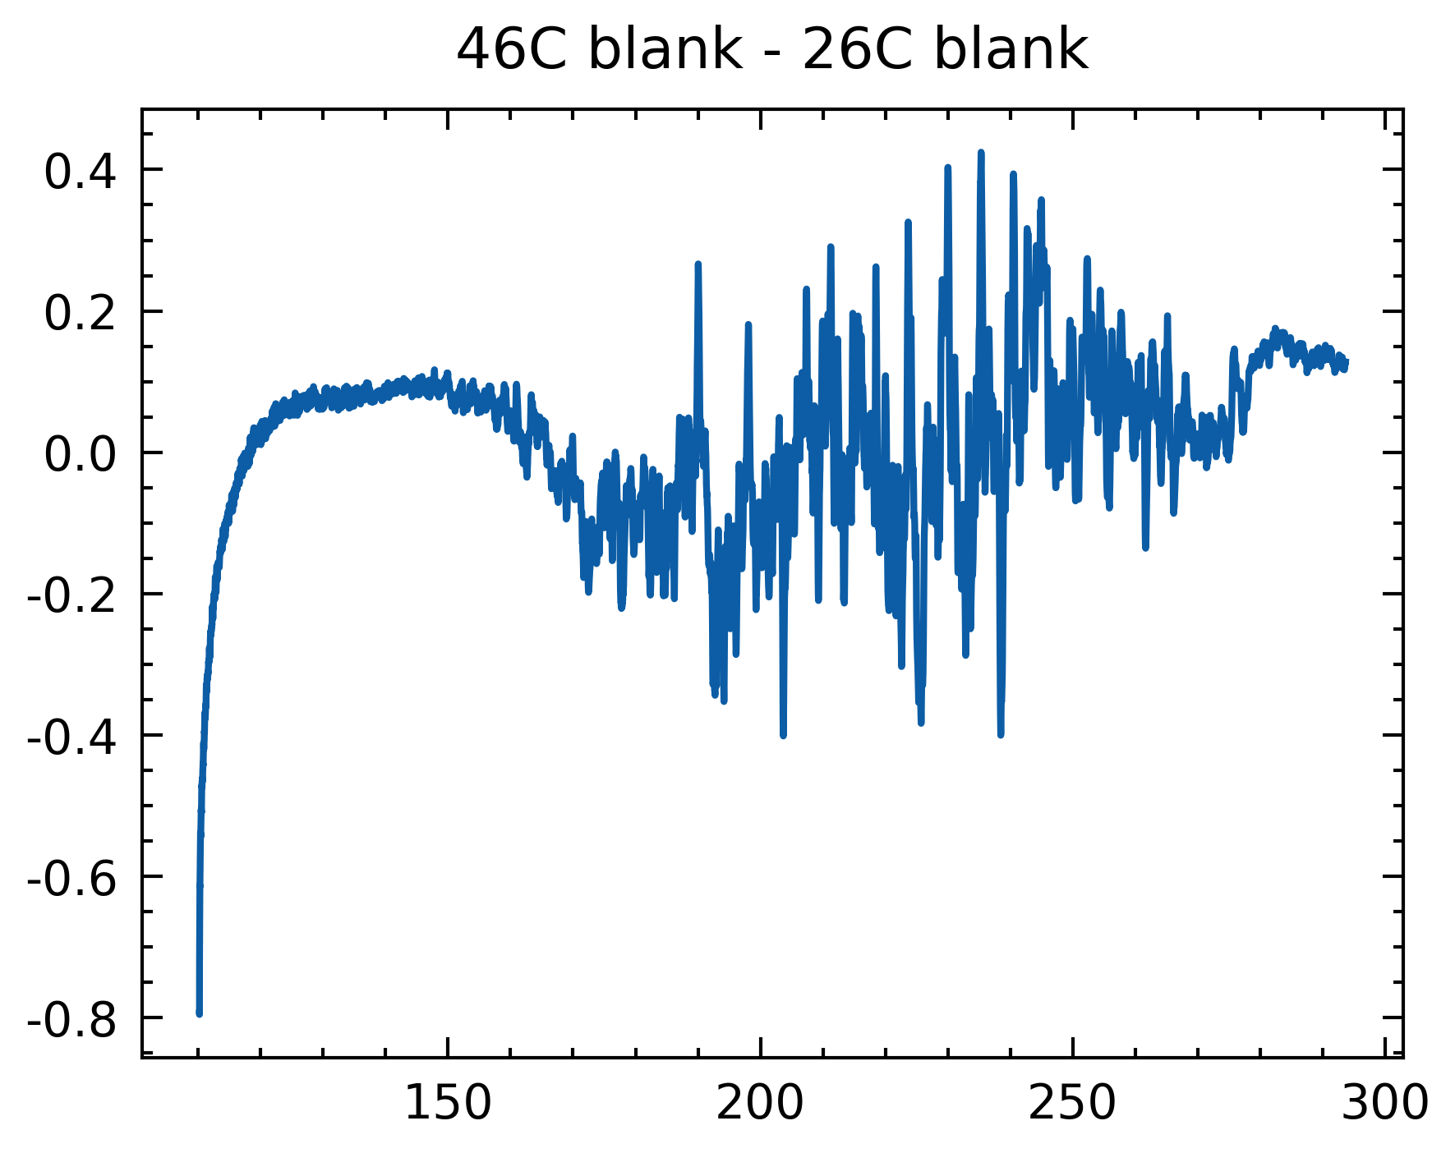
Average smoothing
Reasons for variability:
Melt: propagated variability in calculations: d_T, d_crystalFraction
Both: variability in blank – blank subtraction not perfect, noise variable for different runs (can I use deviations between blank HF as calorimeter noise?)

Slide 7
Average smoothing
Kink at ~295 K:
explained by Tuan in Vu 2019 “This very slight difference between the two thermopiles tends to introduce additional noise that is most prominent around room temperature”

Slide 8
Average smoothing
Which should we proceed with/report?
I would say discrete 1 K average points are most digestible.

Slide 9
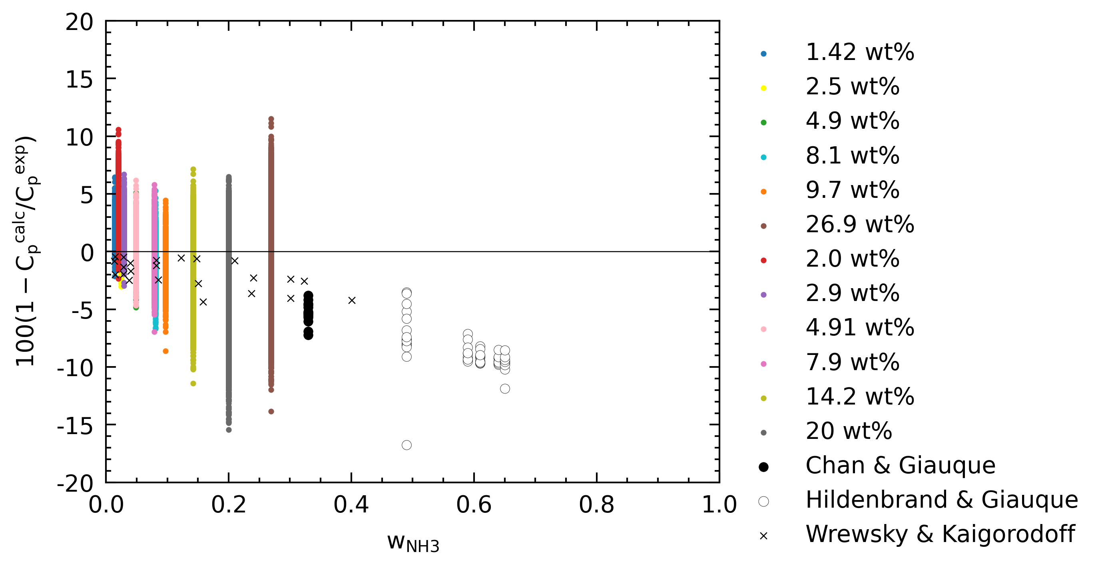
Deviations from TRF (mass fraction)
Tighter spread

Slide 10
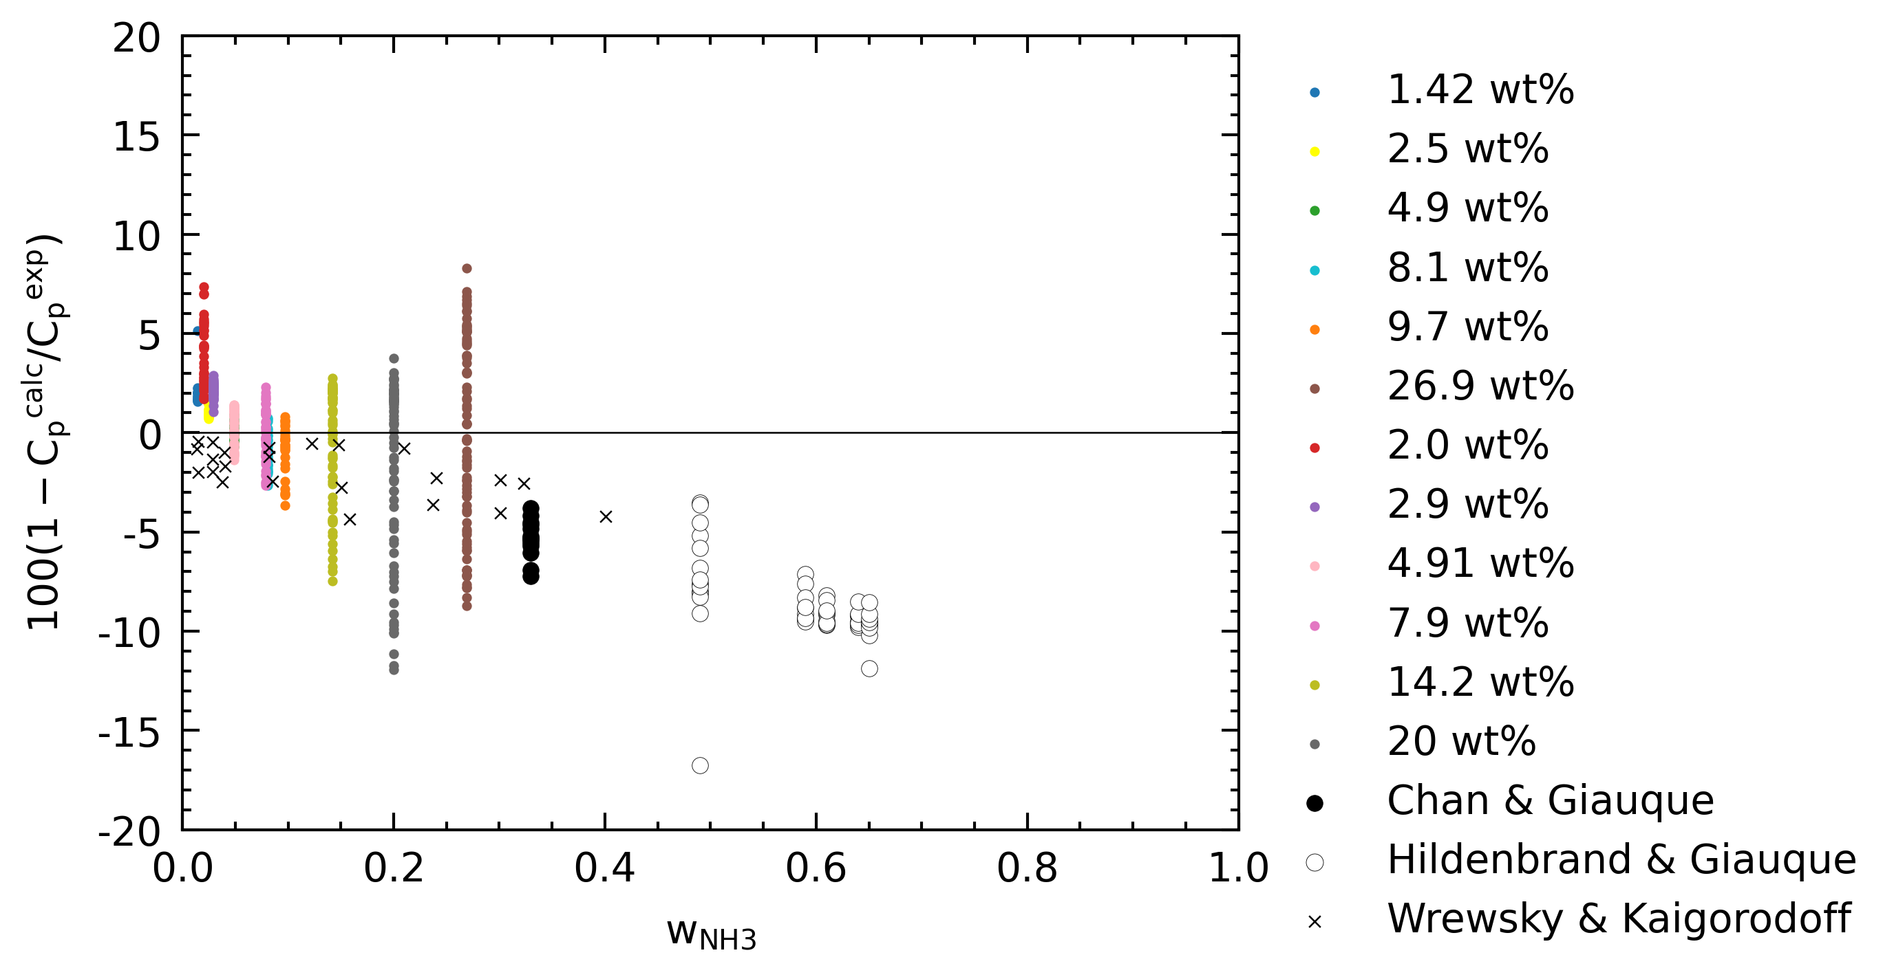
Deviations from TRF (mass fraction)
Tighter spread

Slide 11
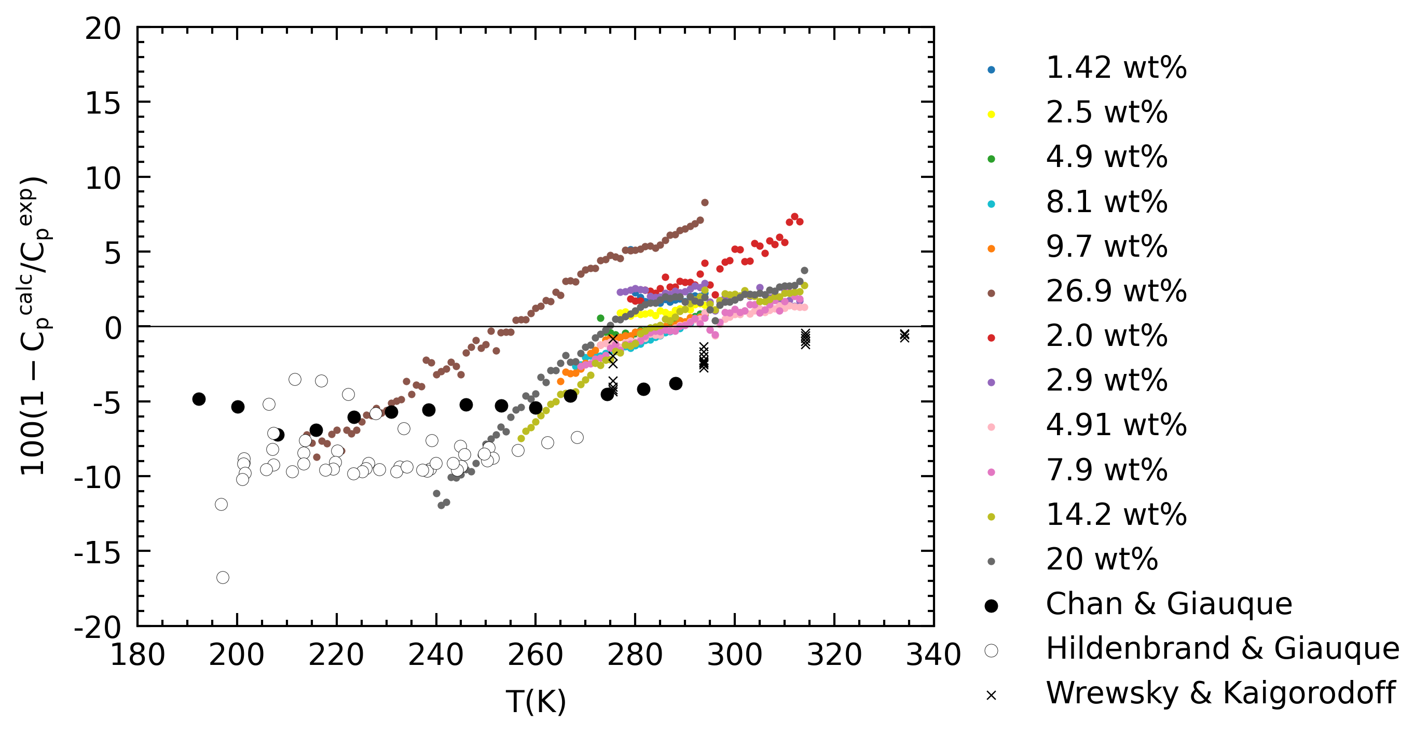
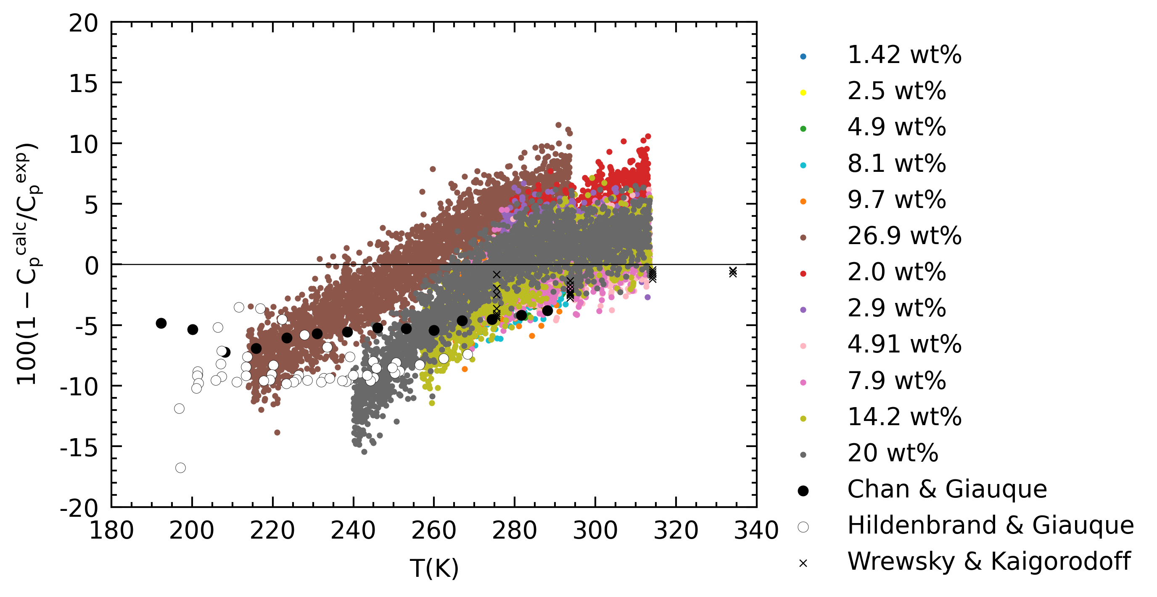
Deviations from TRF (Temperature)
Tighter spread

Slide 12
Deviations from TRF (Temperature)
Tighter spread

Slide 13
Calorimeter T Uncertainty
Goal – Confirm 0.5 K uncertainty reported by Victoria
Other peaks at low T approx. similar deviation
H2O peak deviation is large and always positive
Can we subtract 0.5 K offset for measured peaks, and retrieve accurate wt%?
-0.5 K until what lower T bound? (e.g. 20 wt%, peak at 235 K)
For the 0.5 K number itself, what is it’s uncertainty?

Slide 14
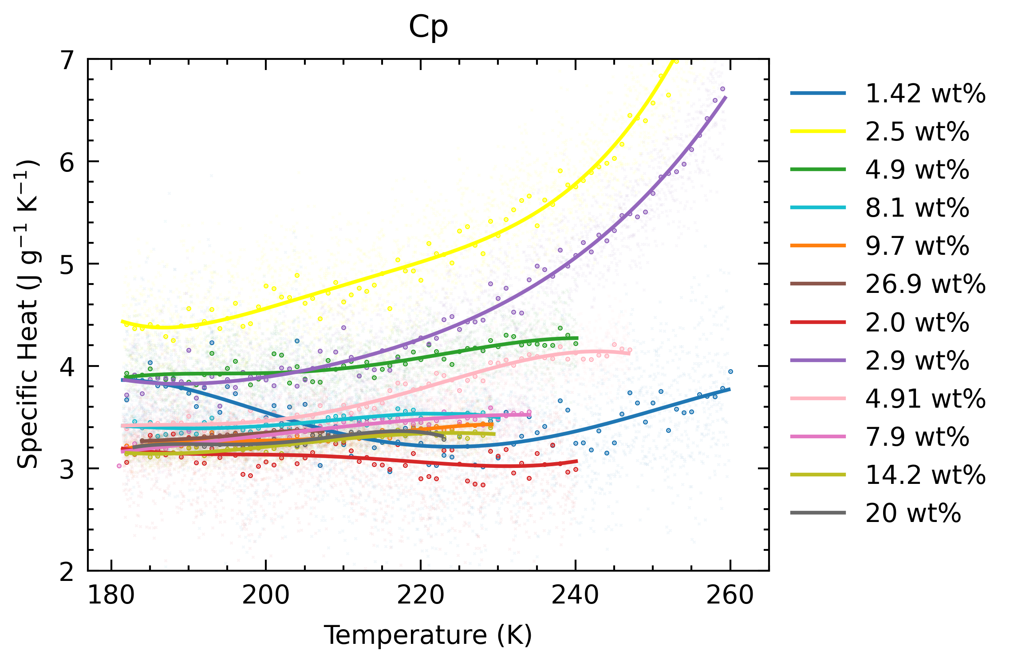
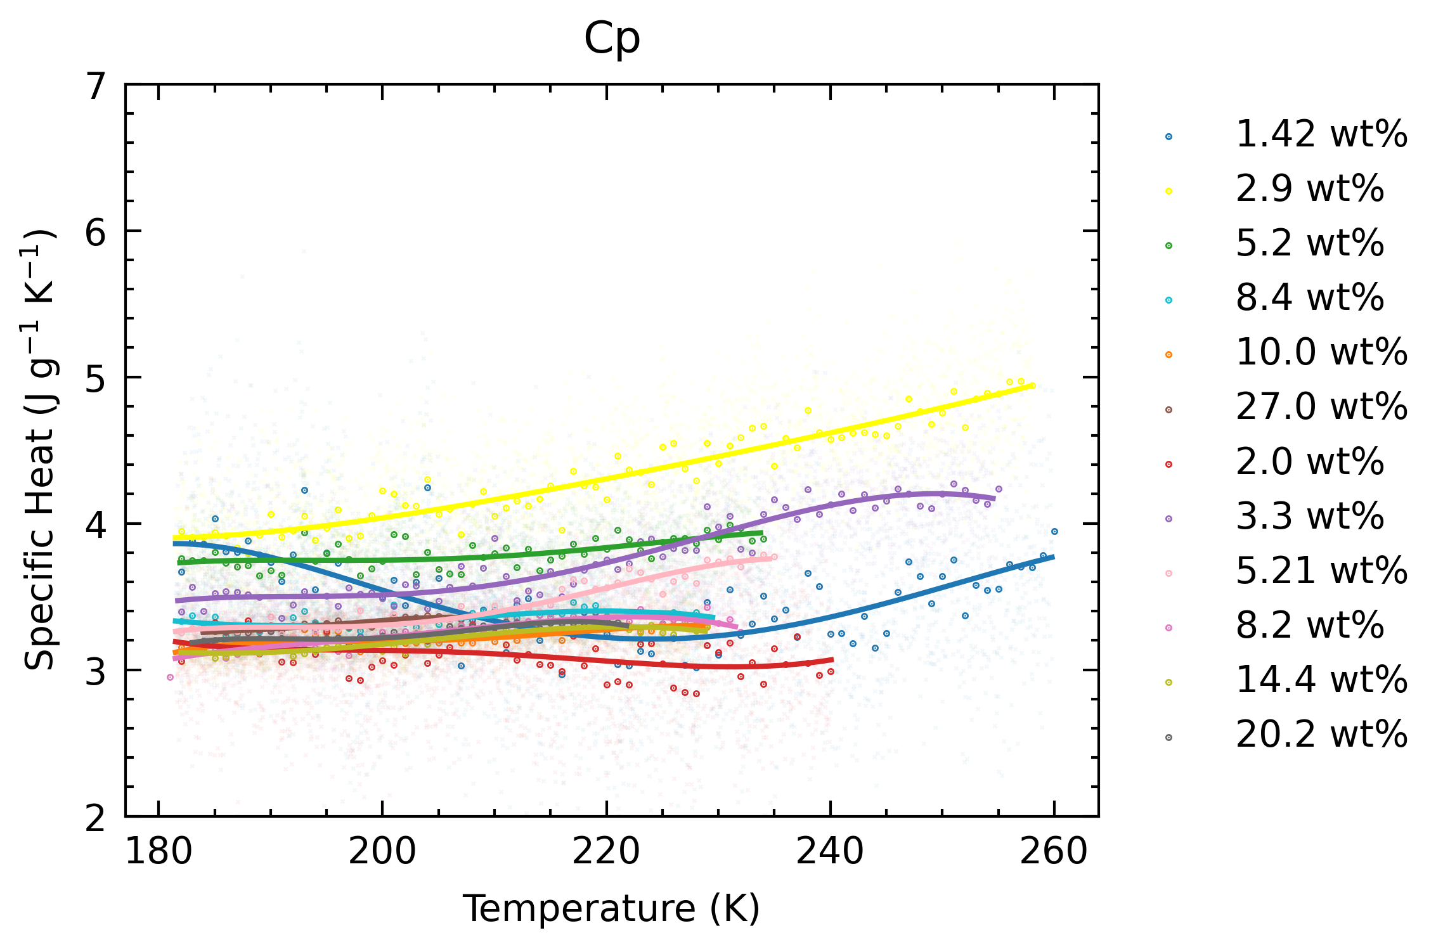
Calorimeter T Uncertainty
Low wt% (<2.0 wt%) still has measured peak > 273.15 K, doesn’t make sense.
0.5 K of H2O measured by onset peak, but our experiments use min peak, additional unconstrained offset.
Lower wt%, larger H2O wt%, greater peak, greater onset – min difference.
No offset
-0.5 K offset

Slide 15
Decision on how to determine wt%
Can we conclude T offset is always positive at liquidus temperatures?
Use 0.5 K as T error, throw away data <5 wt% (n=6), due to 1. sensitivity of wt% to T, and 2. large onset – min peak difference
no
yes
Can we assume T offset is consistent from 230 K to 273 K?
Can we take +0.5 K as T offset, with no error?
Get wt% based on T – offset, and throw away <3.0 wt% (n=4) due to large onset – min peak difference
Do ~2 pure H2O runs to characterize T error
Get wt% based on T – offset, reporting T error and throw away <3.0 wt% (n=4) due to large onset – min peak difference
Can we constrain onset – min peak difference?
Find other solutions with peaks at ~230-250 K to determine T offset dependence on peak T
Get wt% based on variable T – offset, and throw away <3.0 wt% (n=4) due to large onset – min peak difference
Get wt% based on T – offset for <5 wt%, and throw away <3.0 wt% (n=4) due to large onset – min peak difference

Slide 16
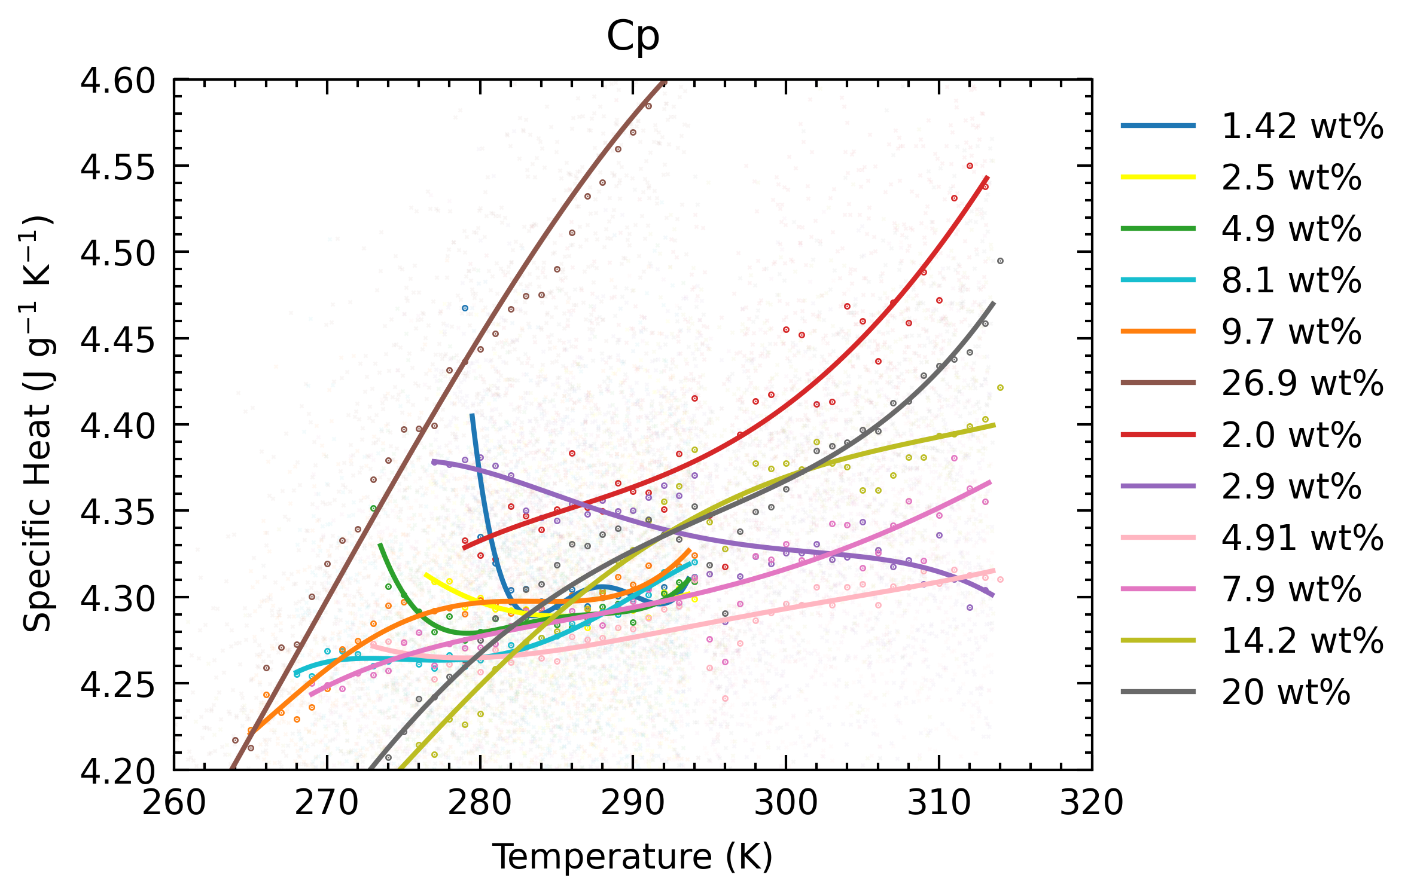
Errors of ~0.34% accounts for ~0.01 difference, so it cannot explain the differences (or error propagation is incorrect). For example, variability of heatflow between runs not accounted for (from discussion above about blanks)
Anomalies
Mostly at low wt%
L shape: increase lower T bound
Red (2 wt%) greater than others
Purple (2.9 wt%) decreasing
Green (4.9) and Light Pink (4.91) are different
Discuss reasons for these anomalies?

Slide 17
Summary
Glovebox Experiments
Volumetric loss via drips accounts for most of density difference from theoretical
Averaging
Calorimeter noise unconstrained. Use blank heatflow variability to represent
Report discrete 1 K average points.
Deviations from literature
Awaiting further discussion
Calorimeter T Uncertainty
Reported 0.5 K is always positive
Decide wt% determination process
Final decision should be reached.
Anomalous Data
Discussion depends on wt% determination and calorimeter noise.

